Slide 1

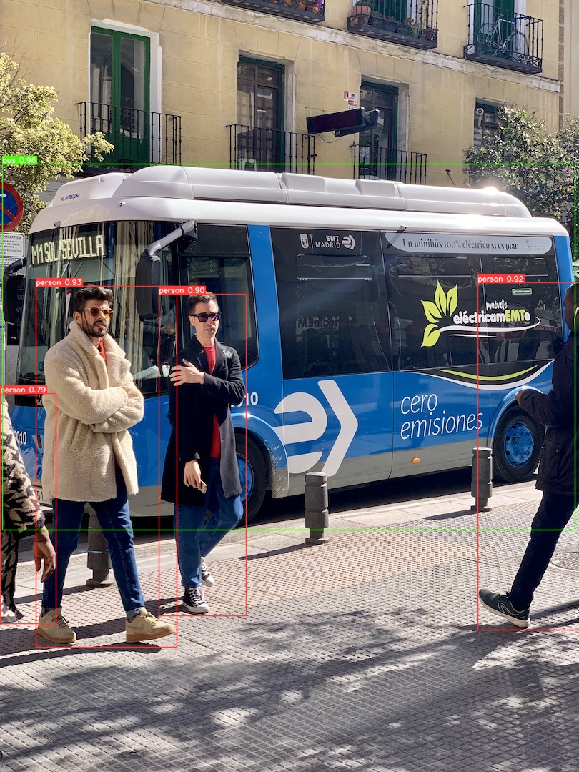



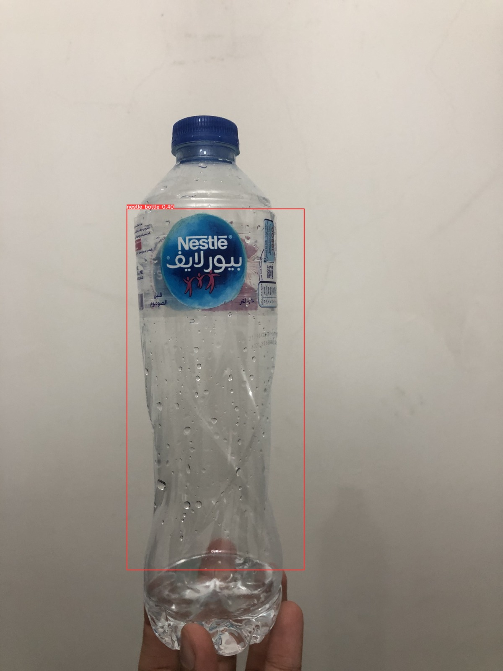
Pocket Lens
Ahmed Mohamed Ismail Nabil – 1180501
Moaz Mohamed Elsherbini – 1180528
Mostafa Ashraf Ahmed Kamal – 1180406
Nader Youhanna Adib Khalil – 1180477
Assoc. Prof. Dr. Mona Farouk
Scene Descriptor
Face Recognizer
Clothes Descriptor
Describe Scenes by speaking object names and depths
Text Reader
BOX 1
Product Identifier
Currency Recognizer
Emotion Recognizer
Arabic

